Slide 1
Lecture 8
Boolean Algebra

Slide 2
Boolean Algebra
George Boole (1815-1864) applied a set of symbols to logical operations.
Digital electronics applies his set theory and logic to (binary) switching networks.
Binary number system is used to represent the two possible states of our systems.
The symbols 0 & 1 are used to represent:
True or False
Flow or No Flow
Open or Closed
Voltage1 or Voltage2
etc.

Slide 3
Boolean Algebra
Deals with manipulation of Variables & Constants
Boolean Variables, such as X, Y, Z, A, B, C, etc. can have "values“ of either 0 or 1. .
0 & 1 are constants & are symbols only, representing two different states of a quantity.
i.e.
F or T
Low voltage or high voltage, usually written L or H
Flow or not flow
e.g. 0V ≡ logical 0
+5V ≡ logical 1
or 0V ≡ 1
+5V ≡ 0
+ ve
logic
- ve
logic

Slide 4

Basic Operations
NOT (compliment or invert)
AND
OR
Only 3
e.g. Not 1 is written as:
Not :
X and Y :
X or Y :
1 or X :
If the variables represent voltages of the I/P or O/P of a switching network, we symbolically represent these operations by:
NOT
If O/P is called C, we write:
1´ or 1
X ´ or X
X • Y
X + Y
1 + X
inversion symbol or “bubble
C = X´

Slide 5
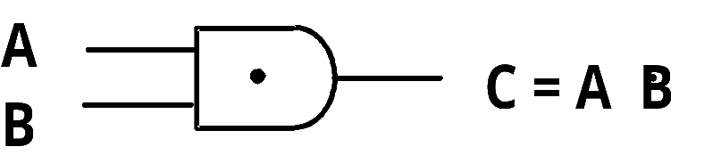
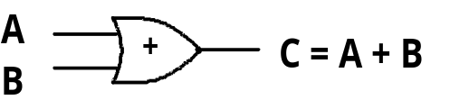
Boolean Operations (cont.)
AND
OR
where values for X, A, B, C are . They actually correspond to two different voltage levels when realized electronically.
e.g.
Characteristics of
an Inverter
0 or 1
0 & 5V; -12V & 0V, etc.
Truth Table
X C
0 1
1 0
if X = 0 C = 1
if X = 1 C = 0

Slide 6
Boolean Operations (cont.)
A
B
AND gate
A
B
C
C = A ● B
0 0 0
0 1 0
0 0
1 1 1
Logical
Multiplication
A
B
OR gate
A
B
C
C = A + B
0
1
1
1
0
0
0
1
Logical
Addition
1
0
Also called Inclusive OR
1
1

Slide 7


Electric Switches as Logical Networks
Each switch is labeled with a variable.
If switch is closed, X =
If switch is open, X =
1
i.e. Current Flows
0
i.e. No current Flows
Consider:
Z
Z = 1 if transmission of signal between 1 & 2 is possible
Z = 0 if not possible
Then algebraically. Z =
A • B

Slide 8
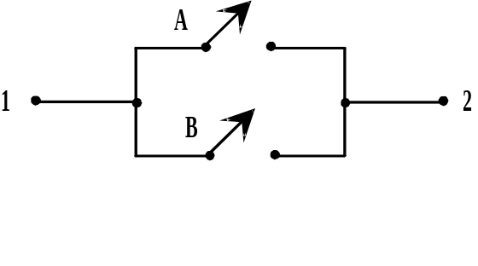
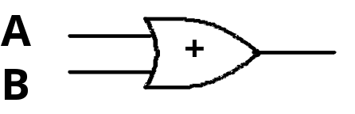
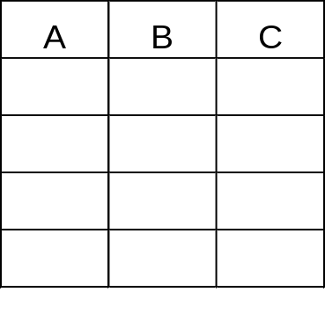
Electric Switch Networks (continued)
Consider:
T =
A + B
A or B (or both) must be closed for transmission
Exclusive OR Function A + B
A + B
0 0 0
0 1 1
0 1
1 1 0
How can we Implement this with switching Ckt. ?

Slide 9
Boolean Expressions
Are formed by application of basic operation to one or more variables or constants
e.g.:
Brackets are used to specify the order operations are performed. If brackets are omitted, order of operations are:
Therefore AB' =
AB' + C =
X´
A+1
A•B+C´ (• usually omitted)
A(B+C)´+D´
or A(B+C) + D´
NOT, AND, OR
A(B ´) = (AB) ´
(A(B ´)) + C

Slide 10


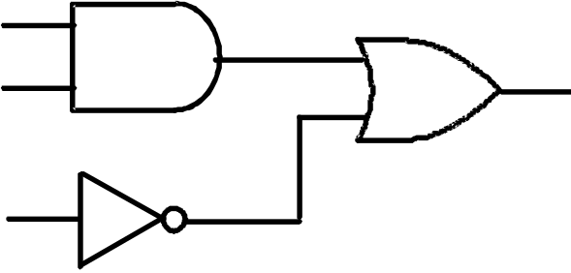
Every expression corresponds directly to a network of logic gates:
X' :
A + 1 :
AB + C' :
X X´
A
A+1
1
A
B AB+C ´
C

Slide 11
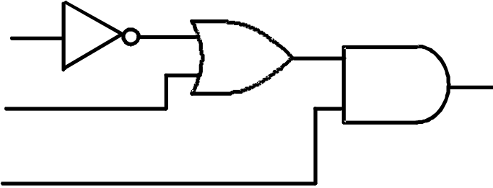
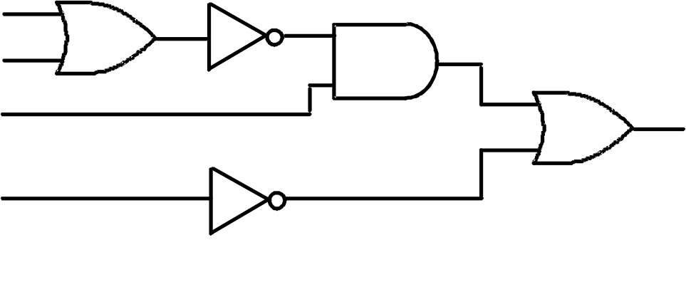
A ( B' + C ) :
A ( B + C)' + D' :
B´
B´+C
B
C A(B ´ +C)
A
You place variables on network
B
C
A
D

Slide 12
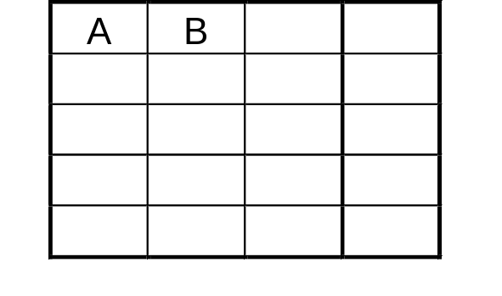
To evaluate an expression, substitute 0 or 1 for each variable, as appropriate:
e.g.: If A = C = 1, & B = D = 0
A ( B + C )' + D' =
Truth table Tabulates values of an expression for every combination of values of the variables. i.e. for each possible input
e.g.: F = AB’
Note that: 2 inputs different input combinations
3 inputs different input combinations
4 inputs different input combinations
Therefore for n-variable expression, rows in truth table.
1(0+1)’ + 0’ = 1(1)’ + 1
= 1•0 + 1 = 0 + 1 = 1
B’ F
0 0 1 0
0 1 0 0
0 1 1
1 1 0 0
All possible combinations
of A and B
➔4
➔8
➔16
2^{N}

Slide 13
Basic Theorems - Single variable
Operations with 0 & 1: 0' = 1 1' = 0
X + 0 = X · 1 =
X + 1 = X · 0 =
Idempotent laws (operations of variable with itself which equals itself): X + X = X X · X = X
Involution law: (X')' =
Laws of complementarily:
X + X' = X · X' =
X
1
X
0
Duals
Duals
X
1
0
Duals

Slide 14
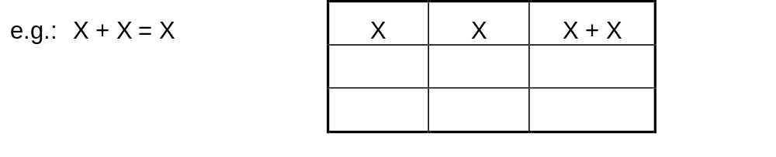
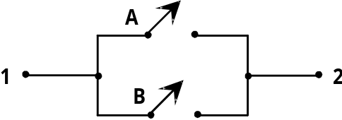
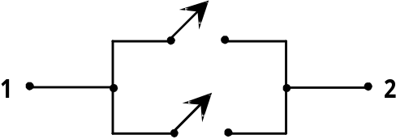

Can use truth tables to prove any law:
0 0 0
1 1 1
or, for simple expressions, by using switches:
recall: T = A + B
(A, B = 1 if closed)
therefore:
Note that any expression may substituted for X in the basic theorems
(sometimes difficult to recognize).
e.g.: AB + C' + D'E + 1 = ( A + BD' ) ( A + BD' )' =
X
X
T= X+X
T= 1 if X=1
= 0 if X=0
≡ X
1
X
X•X’ = 0

Slide 15
Commutative, Associative & Distributive Laws
Involves 2 or more variables
Commutative laws:
XY = YX
i.e. order does not affect operation
Associative laws:
( XY ) Z =
( X + Y ) + Z =
Distributive laws:
1. X ( Y + Z ) =
2. X + YZ =
X+Y = Y+X
X(YZ) = XYZ
Can prove using Truth Tables
X+(Y+Z) = X+Y+Z
AND operation distributes over OR
XY+XZ
OR operation distributes over AND
(X+Y)(X+Z)

Slide 16
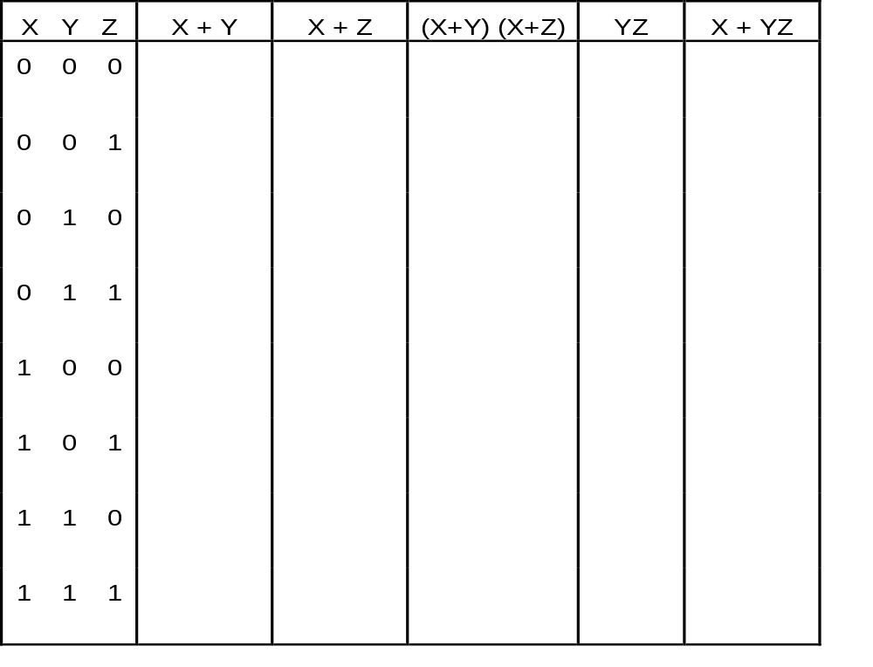
Proof of 2nd distributive law by truth table:
0 0 0 0 0
0 1 0 0 0
1 0 0 0 0
1 1 1 1 1
1 1 1 0 1
1 1 1 0 1
1 1 1 0 1
1 1 1 1 1
The Same

